Slide 1
Classifying pop Music using machine learning
Benjamin Doyle
Python for Data Science, CSCI E-29
Harvard University

Slide 2



CSCI E-29 2018 Staff
Nenad Svrzikapa
Instructor
Lena Hajjar
Teaching Fellow
Philip Lodine
Teaching Fellow
Kaleigh Douglas
Teaching Fellow
Alan Xie
Teaching Fellow
Joe Palin
Teaching Fellow

Slide 3
Abstract
Machine Learning
”Discipline concerned with the implementation of computer software that can learn autonomously.”
Supervised vs. Unsupervised
Supervised = trained
Unsupervised = untrained
https://www.britannica.com/technology/machine-learning

Slide 4

Abstract
Gaussian Naïve Bayes
Supervised Machine Learning Classifier
Probabilistic Classifier
Pop music dataset:

Slide 5
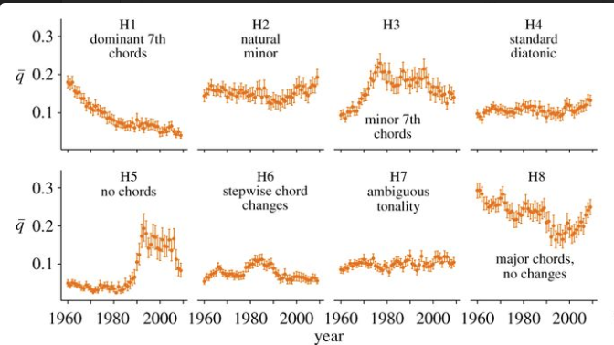
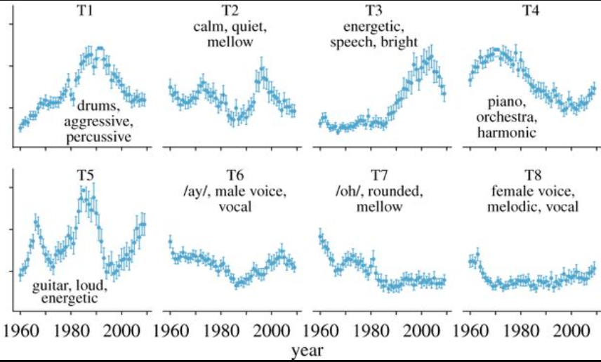

Slide 6
Required Libraries and files
PANDAS
conda install -c anaconda pandas=0.19.2
DATASET URL
https://figshare.com/articles/Main_Dataset_for_Evolution_of_Popular_Music_USA_1960_2010_/1309953
JUPYTER NOTEBOOK URL
https://github.com/bendbir/pop_music_gnb_e29

Slide 7
REFERENCES
https://www.britannica.com/technology/machine-learning
https://machinelearningmastery.com/better-naive-bayes/
https://jakevdp.github.io/PythonDataScienceHandbook/05.05-naive-bayes.html
https://stats.stackexchange.com/questions/23490/why-do-naive-bayesian-classifiers-perform-so-well
https://figshare.com/articles/Main_Dataset_for_Evolution_of_Popular_Music_USA_1960_2010_/1309953 (dataset)
http://rsos.royalsocietypublishing.org/content/2/5/150081 (article)

Slide 8
Acknowledgments
Nenad Svrzikapa
Course TFs:
Lena Hajjar
Philip Lodine
Kaleigh Douglas
Alan Xie
Joe Palin
Fellow Classmates in CSCI E-29

